Slide 1

SMS Spam Classification
Ali Malenchik

Slide 2

Background
Spam detection enhances the communication experience.
Spam is unwanted, annoying, and frustrating.
Machine learning can use historical message data to predict spam so that it can be filtered out.

Slide 3

Problem Statement
Can a machine learning algorithm accurately predict whether an SMS message is spam?

Slide 4
Scope & Assumptions
Natural language processing will be used to tokenize and vectorize the message data.
The best model is the one which accurately identifies the spam, without falsely categorizing “ham” messages as spam.
Hyperparameter tuning will not be performed as part of this project.

Slide 5
Methods

Slide 6




Data Source
Sourced from Kaggle
CSV format
Two columns: Message, Category
Category Values: spam or “ham”
Messages were initially gathered by the following sources:
The Grumbletext website, which is a UK forum for cell phone users to report received spam messages
NUS SMS Corpus from the Department of Computer Science at the National University of Singapore
A PhD Thesis created by Caroline Tag
SMS Spam Corpus v.0.1 Big

Slide 7
Data Import & Cleansing
5572 records at time of import
No null values
Imbalanced target class
New features calculated:
num_chars: number of characters in each message
num_words: number of words in each message
Split data into 33% test, 67% train
Encode target variable to 1=spam, 0=ham.

Slide 8
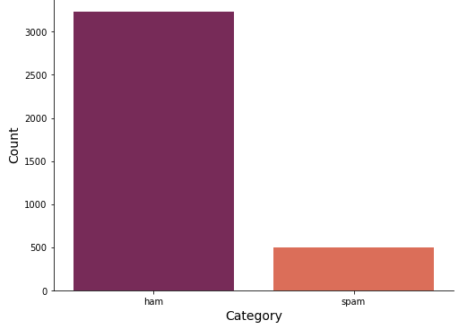
Exploratory Analysis Count Plot of SMS Message Category for Training Dataset

Slide 9
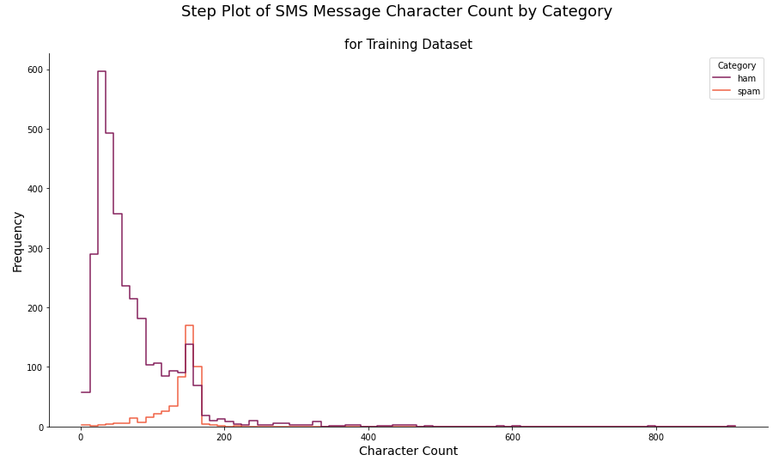
Exploratory Analysis Step Plot of SMS Message Character Count by Category

Slide 10
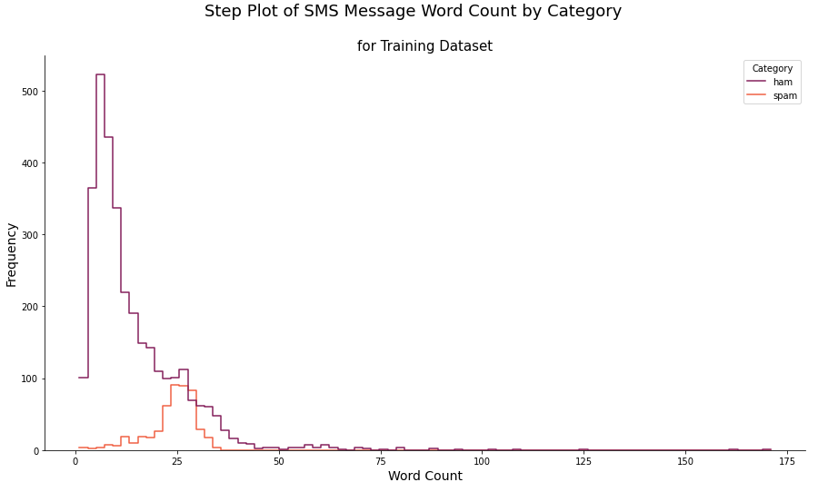
Exploratory Analysis Step Plot of SMS Message Word Count by Category

Slide 11
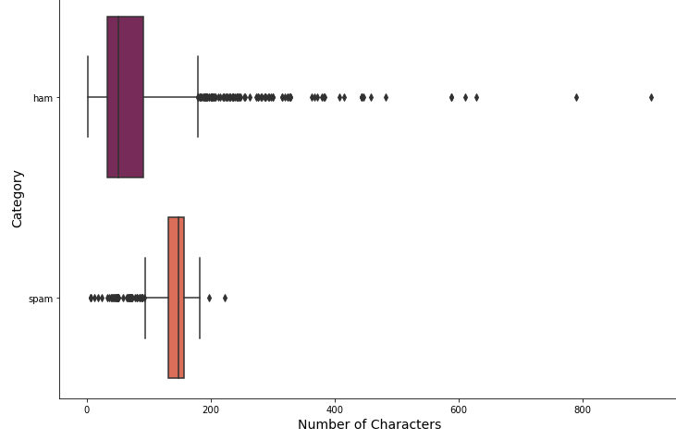
Exploratory Analysis Box Plot of SMS Message Character Count by Category

Slide 12
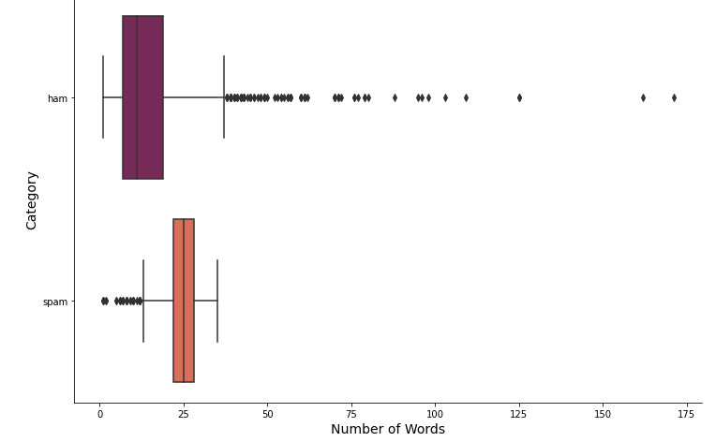
Exploratory Analysis Box Plot of SMS Message Word Count by Category

Slide 13
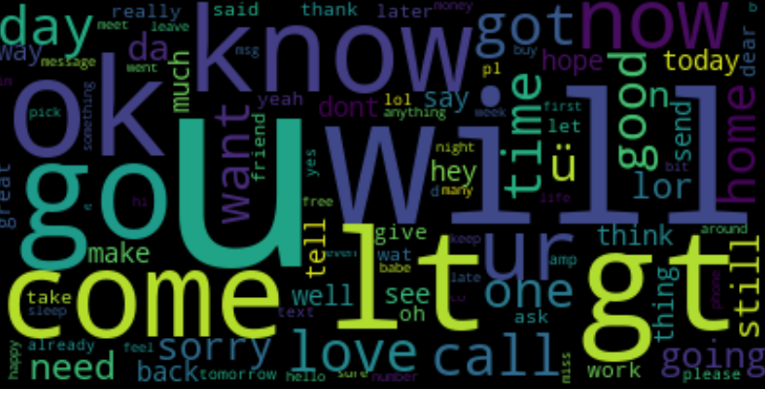
Exploratory Analysis Word Cloud for Ham SMS Messages

Slide 14
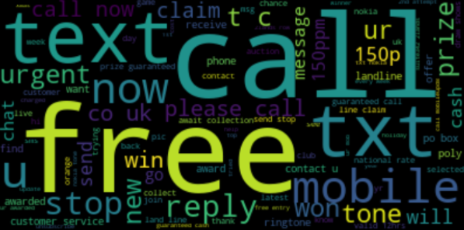
Exploratory Analysis Word Cloud for Spam SMS Messages

Slide 15
Feature Selection
Tokenization
Non-alphanumerics removed
Stop words removed
Converted to lower case
Lemmatization

Slide 16
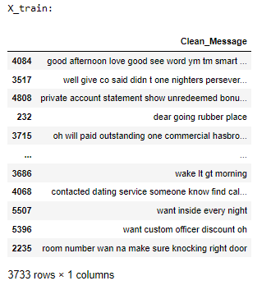
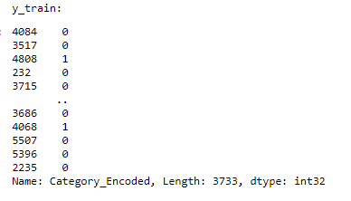
Feature Selection (cont.)
Independent & Dependent Variables split:
X_train
y_train

Slide 17
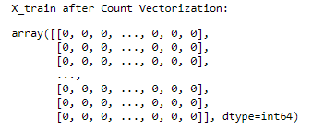
Feature Selection (cont.)
Count Vectorization
X_train

Slide 18
Model Deployment
Random Forest
Naïve Bayes
Logistic Regression
Support Vector Machine
Decision Tree

Slide 19
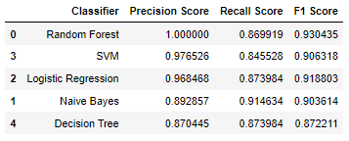
Results

Slide 20
Conclusion
Random Forest is the best performing spam classifier at 100% precision and 87% recall.

Slide 21
Opportunities for Improvement
Gather additional spam SMS messages to balance the dataset
Perform hyperparameter tuning & optimize performance

